Slide 1
Accelerate r applications with CUDA
Patric Zhao
patricz@nvidia.com

Slide 2
Agenda
Background
Deploy CUDA Libraries
Apply DIRECTIVES
Combine CUDA C/C++/Foratran
Case study : kNN
Appendix:
Build R with CUDA by Visual Studio 2013 on Windows

Slide 3
1.Background
Advantages of R:
Help to think with statistical methods
Design for data orientation
Interactive with other databases
Integrate with other languages
Provide high quality graphics
Drawbacks of R:
speed : sometimes is very slow
memory: requires all data to be loaded into major memory (RAM)
So, we will introduce a way to resolve ‘slow speed’ of R.
Notes:
First of all , I’d like to talk the advantages of R, and that is the reason why R is so popular in community and industry.
R provides great number of statistical models which are written by statists so it helps the user think with correct methods.
Next, R is designed for data orientation, so you can more focus on data rather than programming, and it works very well on large groups of data such as apply series functions in R.
And, obviously, data oriented design can explore larger parallelism. Furthermore, R is easy to interactive with other databases and integrate with other languages. That’s the reason why we can apply CUDA eco-system into R.
But, two major drawbacks of R we have to mention in here. Sometimes it will be very slow, such as we use loop structure.
We may ask why R is so slow? First, R is an interpreted language. When execute one command in R, it is translated to machine code first, and then R loads the machine code to CPU to execute.
Therefore, think about if we write a loop to iterate one command for 100 times, R needs to interpreted this statement 100 times. But if we use vector method, R only needs to interpret 1 time for all data.
Another reason is that R is single-threaded program. We can’t get benefit from multi-cores architecture.
Second problem is memory operation. R requires all data to be loaded into major memory. Today, we will focus on first issue and introduce a way to accelerate R by GPU.

Slide 4
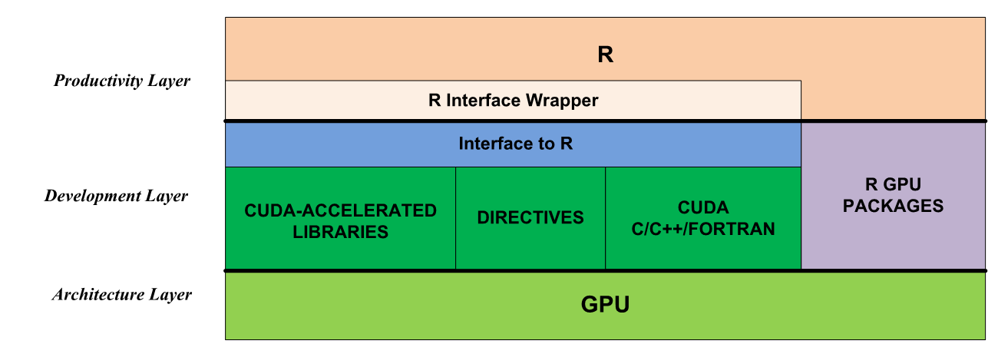
R Software Stack with cuda
R GPU Packages : easy to use
CUDA Libraries : high quality, usability, portability
DIRECTIVES : both CPU and GPU
CUDA C/C++/Fortran : high performance & flexibility
Notes:
Now, let’s show the software stack of R. Because R cant access GPU directly, we have to write several intermediate layers.
Currently, these are several R GPU packages on CRAN which shows great performance improvements from GPU and easy to use, such as gputools, rthrust.
On the other hand, the number of GPU packages is currently limited, quality varies, and only a few domains are covered.
So, we still need to develop our own GPU codes or packages. In this talk, I am going to introduce three approaches to accelerate R codes by GPU, including CUDA libraries, directives and CUDA languages.

Slide 5
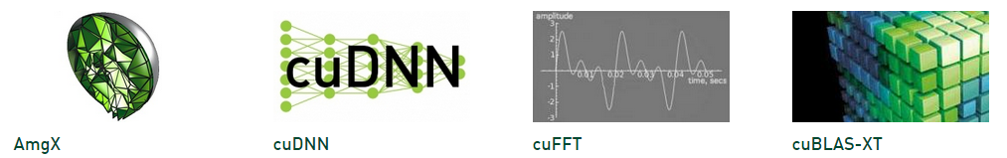

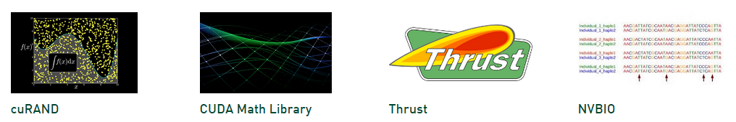
2. Deploy CUDA Libraries to R
Excellent usability, portability and performance
Less development efforts and risks
https://developer.nvidia.com/gpu-accelerated-libraries
Notes:
OK, let’s start the body from CUDA libraries. As you know, there are many GPU-accelerated libraries that provide excellent usability, portability and performance. Using GPU-accelerated libraries can reduce development effort and risk. Thus, using CUDA libraries is a quick way to speed up applications, without requiring the R user to totally understand GPU programming.

Slide 6
Two examples :
Accelerate Basic Linear Algebra Subprograms (BLAS)
how to use drop in library with R
Accelerate Fast Fourier Transform (FFT)
how to deploy CUDA APIs
how to build, link and use CUDA shared objects (.so)
Notes:
In this talk, I will give two examples for CUDA libraries. The first one will teach how to use drop in libraries with R; and second case is more general, which shows how to call CUDA APIs from C code and than build and link it to R.

Slide 7
Case 1. Accelerate Basic Linear Algebra Subprograms (BLAS)
Target : speedup R BLAS computation, such as %*%
R applications
R standard interface Rblas.so
Various CPU BLAS implementations
cuBLAS/NVBLAS
Intel MKL CPUs
OpenBLAS
Fermi GPU
Kepler GPU
Maxwell GPU
Notes:
OK, we start with BLAS which is mostly used in lots of applications. Normally, R will call standard interface of blas in R, Rblas.so which is a single thread library.
For CPU multi-core architecuture, the Intel MKL and OpenBLAS are mutli-threaded solutions for BLAS, which are widely used with R. Similarly, CUDA provides the GPU accelerated
BLAS library as well.

Slide 8
Drop-in NVBLAS Library on Linux
The wrapper of cuBLAS
Includes Standard BLAS3 routines
gemm, syrk, herk, trsm…
Supports Multiple-GPUs
ZERO programming effort
Q: How to use it with R ?
A: Simple PRE-LOAD nvblas.so on Linux
Normally : R CMD BATCH <code>.R NVBLAS :
env LD_PRELOAD=libnvblas.so R CMD BATCH <code>.R
Notes:
For more details, the GPU BLAS library is cuBLAS which includes 3 levels of standard BLAS functions.
NVBLAS is a wrapper of cuBLAS, which includes computational intensive function of level 3 of BLAS and supports multiple-GPUs.
NVBALS can work on Linux platform with ZERO programming effort.
Now, let’s figure out how to use it! It’s as simple as we use R normally.
We just need to preload nvblas library by LD_PRELOAD environment and then the cuBLAS routine will overwrite standard BLAS API.

Slide 9
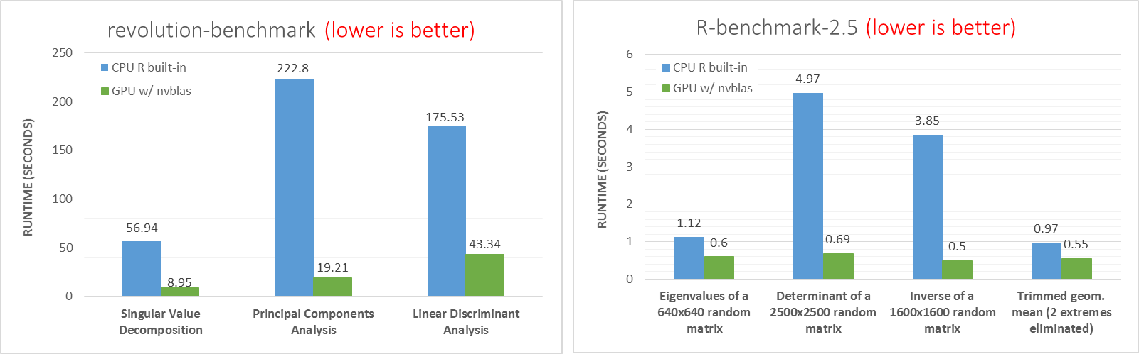
Benchmark Results
revolution-benchmark & R-benchmark-2.5
CPU : Intel, Sandy Bridge E5-2670, Dual socket 8-cores, @ 2.60GHz, 128 GB
GPU : NVidia, Kepler, K40m, 6GB memory
Notes:
Now, let’s see how GPU accelerate BLAS in our benchmarks. Here, I show the results from two R benchmarks which tested several very common algorithms of data scientist such as SVD, PCA, LDA.
The left result is from revolution-benchmark and the blue bar is from CPU while the green bar from GPU. Actually, the runtime from GPU is significantly short than CPU. Take PCA for example,
The GPU is 10X faster than CPU. And the similar results also come from R-benchmark-2.5.

Slide 10
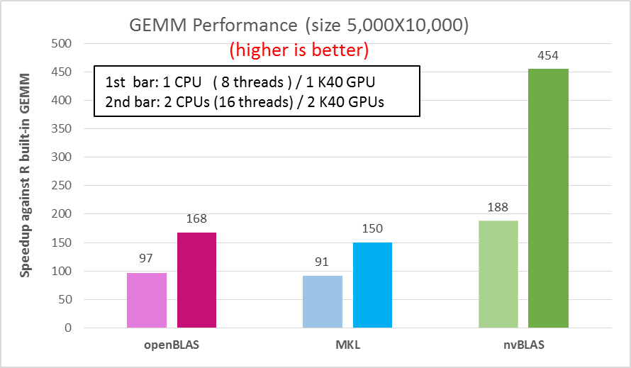
Multi-GPUs Case : GEMM (General Matrix Multiplication)
Just add more GPU index in nvblas.conf file
NVBLAS_GPU_LIST 0 1
Compared with CPU multi-threads, GPU gains
higher speedup than multi-threads solutions
great scalability applied multi-GPUs
Notes:
Following single GPU performance, let’s take a look the multi-GPU case. We tested the performance of GEMM by openBLAS, MKL in 1 or 2 CPUs, and then compared with the performance of nvBLAS in GPU.
In this picture, we shows the speedup against single-thread solution. 1 CPU (8 threads) performance from openBLAS and MKL is almost similar about 90X faster than builtin R blas; while the 1 GPU perfroamnce is about 2X times faster than 1 CPU results. And then, you can see the 2 GPU speed gains about 3X faster than 2 CPU (16 threads) solution and 450X faster than R built in routine.
So, there is really an awesome result by GPU!

Slide 11
Case 2. Accelerate Fast Fourier Transform (FFT)
How to link CUDA libraries to R, including
Determine R target function
Write an interface function
Compile and link a shared object
Load shared object in wrapper
Execute in R
Test Performance
Notes:
Change to case 2, this is a more general case to show you how to use CUDA librarie to R, including :
……

Slide 12
Target Function in R
Basic compute pattern in finance, image processing, …
such as stats:convolve() function in R is implemented by fft()
Fast Discrete Fourier Transform
Description
Performs the Fast Fourier Transform of an array.
Usage
fft(z, inverse = FALSE)
Arguments
z : a real or complex array containing the values to be transformed.
inverse : if TRUE, the unnormalized inverse transform is computed (the inverse has a + in the exponent of e, but here, we do not divide by 1/length(x))
Notes:
First, we need to determine which function we want to accelerate by GPU. In this case, we take FFT for example, which are widely used in finance, image processing, single processing.
And several R built-in functions, such as convolve, are implemented by FFT, so if we can accelerate FFT by GPU; other routines based on FFT will be speedup as well.

Slide 13
#include <cufft.h>
void cufft(int *n, int *inverse, double *h_idata_re,double *h_idata_im, double *h_odata_re, double *h_odata_im)
{ cufftHandle plan;
cufftDoubleComplex *d_data, *h_data;
cudaMalloc((void**)&d_data, sizeof(cufftDoubleComplex)*(*n));
h_data = (cufftDoubleComplex *) malloc(sizeof(cufftDoubleComplex) * (*n));
// Covert data to cufftDoubleComplex type
for(int i=0; i< *n; i++) {
h_data[i].x = h_idata_re[i];
h_data[i].y = h_idata_im[i];
}
cudaMemcpy(d_data, h_data, sizeof(cufftDoubleComplex) * (*n), cudaMemcpyHostToDevice);
/* Use the CUFFT plan to transform the signal in place. */
cufftPlan1d(&plan, *n, CUFFT_Z2Z, 1);
if(!*inverse ) {
cufftExecZ2Z(plan, d_data, d_data, CUFFT_FORWARD);
} else {
cufftExecZ2Z(plan, d_data, d_data, CUFFT_INVERSE);
}
cudaMemcpy(h_data, d_data, sizeof(cufftDoubleComplex) * (*n), cudaMemcpyDeviceToHost);
// split cufftDoubleComplex to double array
for(int i=0; i<*n; i++) {
h_odata_re[i] = h_data[i].x;
h_odata_im[i] = h_data[i].y;
}
/* Destroy the CUFFT plan. */
cufftDestroy(plan);
cudaFree(d_data);
free(h_data); } //main
Writing an interface function
Standard workflow for interface function
declare for R
allocate memory for CPU and GPU
Copy memory from CPU to GPU
Call CUDA API
Copy memory back from GPU to CPU
Free memory
Notes:
Because R can’t access GPU directly as I mentioned previously, we have to write a C/C++/Fortorn interface function to call CUDA API as this code shown.
Even it looks a little complex, actally, this is a standard workflow for calling any CUDA API.

Slide 14
Compile and link to Shared Object (.so)
nvcc -O3 -arch=sm_35 -G -I/usr/local/cuda/r65/include \
-I/home/patricz/tools/R-3.0.2/include/ \
-L/home/patricz/tools/R/lib64/R/lib –lR \
-L/usr/local/cuda/r65/lib64 -lcufft \
--shared -Xcompiler -fPIC -o cufft.so cufft-R.cu
Load Shared Object (.so) in Wrapper
cufft1D <- function(x, inverse=FALSE)
{
dyn.load("cufft.so")
n <- length(x)
rst <- .C("cufft",
as.integer(n),
as.integer(inverse),
as.double(Re(z)),
as.double(Im(z)),
re=double(length=n),
im=double(length=n))
rst <- complex(real = rst[["re"]], imaginary = rst[["im"]])
return(rst)
}
Notes:
After we wrote an interface function for CUDA API, we can compile it by nvcc as this command shown on Linux. If you are working on Window, please see the appendix part in this slide, we can build DLL file as well by visual studio. And then, we need to load the shared object file by dyn.load and use .C to call interface function in R. In here, cufft is the interface function we shown in previous page.
In practice, we can write a wrapper function to hide these detail information and make the CUDA call like a R accent function in here.

Slide 15
Execute and Testing
> source("wrap.R")
> num <- 4
> z <- complex(real = stats::rnorm(num), imaginary = stats::rnorm(num))
> cpu <- fft(z)
[1] 1.140821-1.352756i -3.782445-5.243686i 1.315927+1.712350i -0.249490+1.470354i
> gpu <- cufft1D(z)
[1] 1.140821-1.352756i -3.782445-5.243686i 1.315927+1.712350i -0.249490+1.470354i
> cpu <- fft(z, inverse=T)
[1] 1.140821-1.352756i -0.249490+1.470354i 1.315927+1.712350i -3.782445-5.243686i
> gpu <- cufft1D(z, inverse=T)
[1] 1.140821-1.352756i -0.249490+1.470354i 1.315927+1.712350i -3.782445-5.243686i
Notes:
Now, testing in R console, the CUDA version is as similar as R built-in function and we can get the same results.
For high level user, the wrapper function in R can hide all detailed information.

Slide 16
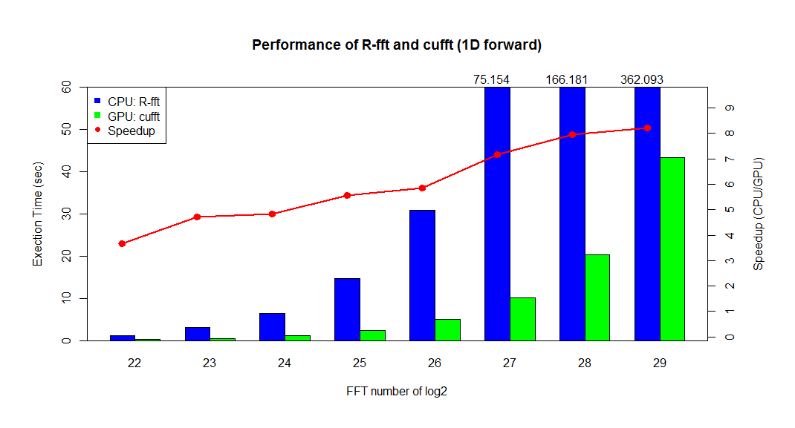
Intel® Xeon® CPU 8-cores (E5-2609 @ 2.40GHz / 64GB RAM)
NVIDIA GPU (Tesla K20Xm with 6GB device memory)
Notes:
Compared the CPU fft with GPU fft, we can get about 8X speedup for large inputs.

Slide 17
3. Apply directives
Directives is a common programming model now
Easy Programming : only add several ‘#pragma’ statement
Portability: compiler, devices, performance
Works for legacy code: huge efforts to rewrite
Implementations in C/C++/Fortran level
CPU : Coarse granularity, task/data parallel w/ OpenMP
GPU : Finer granularity, data parallel w/ OpenACC
Notes:
After introduction for CUDA libraries, I will talk about how to apply directives into R. Recent years, directives becomes a common programming model in parallel computing field because it is easy programming, good portability. Especially, it needs less efforts to accelerate legacy code to avoid rewrite the whole algorithm.
In this talk, I will introduce the implementation from C/C++/Fortran level for CPU and GPU.
CPU directives is fit for high level parallelism such as openMP, while GPU directives is good for low level parallelism.

Slide 18
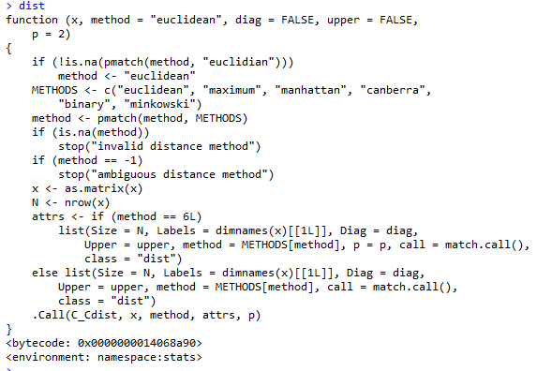
Example: speedup legacy code in dist()
Compute the distances between the rows of a data matrix
Implemented by C function
Call C function, C_Cdist
Notes:
I will show how directives work with R in here by distance function which is implemented by C function.
Dist() function can compute the distance by specified measurement between the rows of a data matrix.

Slide 19
Tips: 1. Reorganize code structure for GPU friendly
2. Several R functions can’t be ported to GPU, such as isnan
3. Notice data copy method/size between CPU and GPU
4. Avoid much logical checks on GPU
5. Use ‘-Mlarge_arrays’ compiler option for big data
source code: <R source code path>/src/library/stats/src/distance.c
static double R_euclidean(double *x, int nr, int nc, int i1, int i2)
{
double dev, dist;
int count, j;
count= 0;
dist = 0;
for(j = 0 ; j < nc ; j++) {
if(both_non_NA(x[i1], x[i2])) {
dev = (x[i1] - x[i2]);
if(!ISNAN(dev)) {
dist += dev * dev;
count++;
}
}
i1 += nr;
i2 += nr;
}
if(count == 0) return NA_REAL;
if(count != nc) dist /= ((double)count/nc);
return sqrt(dist);
}
//Patric: Fine granularity parallel by openACC
//#include <cmath>
static double R_euclidean(double *x, int nr, int nc, int i1, int i2)
{
double dev, dist;
int count, j;
dist = 0;
dev = 0;
count = 0;
//#pragma acc routine(std::isnan) seq
#pragma acc data copyin(x[0:nc*nr-1]) copy(dist)
#pragma acc parallel for \
firstprivate(nc, nr) \
private(j,dev,dist) \
reduction(+:dist)
for(j = 0 ; j < nc ; j++) {
dev = (x[i1 + j*nr] - x[i2 + j*nr]);
dist += dev * dev;
}
// if(count == 0) return NA_REAL;
// if(count != nc) dist /= ((double)count/nc);
return sqrt(dist);
}
Notes:
Now, we check out the source code of dist(), you can find it by grep command on Linux. In here, I don’t explain more details about openACC’s grammar and you can find the related sessions on GTC.
Well, I want to highlight several tips when you work with directives.
1. Even directives can reduce the code changes in principle, we still need to reorganize the code structure for high performance in practice.
2. R includes lots of logical functions such as is.nan, is.null, …, which may can’t port to GPU. So, assume and guarantee the data is clear before pass to GPU.
3. Notice data copy between CPU and GPU, remove unnecessary data copy
4. As point 2, avoid much logical cheks
5. Finally, if your data size is huge, use compiler option ‘-Mlarge_arrays’

Slide 20
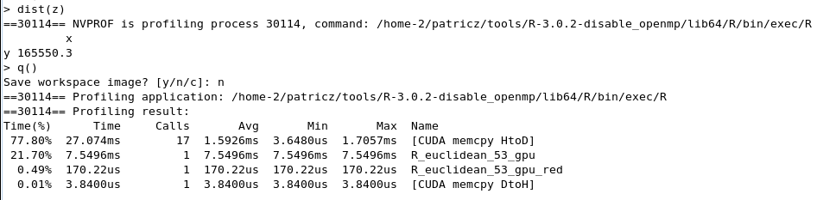
R_euclidean:
53, Generating copyin(x[:nr*nc])
Generating copy(dist)
54, Accelerator kernel generated
54, Sum reduction generated for dist
55, #pragma acc loop gang, vector(256)
/* blockIdx.x threadIdx.x */
54, Generating Tesla code
Compile with PGI
Do ‘make VERBOSE=1’ in stats/src
this step will generate detail information for build
Compile distance.c by PGI
original: gcc -std=gnu99 … -c distance.c -o distance.o
changed: pgcc -acc -ta=nvidia -Minfo … -c distance.c -o distance.o
3. Link all .o file to .so by PGI
original: gcc -std=gnu99 -shared -o stats.so init.o <all.o> ….
changed: pgcc -acc -ta=nvidia –shared -o stats.so init.o <all.o> …
4. Updata stats.so
cp stats.so <R-path>/lib64/R/library/stats/libs/
5. Launch R and Execution as normally
use nvprof to confirm : nvprof R ….
Notes:
Let’s see how to compile this code by PGI. The ideal approach is to change the Makefile and let PGI to compile all files for this packages; but it needs much efforts to understand all details and it’s unnecessary.
In here, I introduce a trick method.
1. First, in the source code directory, build the package as previously;
2. Find out how the taget file was built, and change gcc to pgcc
3. Find out how the final shared object was linked, and change the compiler to pgcc
4. Update so file

Slide 21
Results
Testing code from R:
a <- runif(2^24, 1, 5)
b <- runif(2^24, 1, 5)
x <- rbind(a,b)
system.time( dist(x) )
Vector (2^24) | Runtime (sec) | Speedup
R built-in dist() | 0.207
OpenACC | 0.093 | 2.23X
CPU Intel(R) Xeon(R) CPU E5-2609 @ 2.40GHz / 64 GB RAM
GPU Tesla K20Xm with 6GB device memory
Notes:
A simple testing for computing the distance of two large vector is shown in here, and GPU gets 2X speedup from OpenACC.
BTW, I just post a simple implementation of dist in previous page which didn’t get the best performance, and you can continue to optimize this function for a practice.

Slide 22
3. Combine CUDA Languages to R
Existing libraries cant meet up function/performance target
Write up your own functions and do optimization
Same flow with calling CUDA library
- Just change the CUDA API to your own kernel
Notes:
Now, we change to the last method of this talk, combine CUDA languages to R.
When existing libraries can’t meet up your functional and performance target, we can write up your own algorithm by CUDA.
And it is same flow with calling CUDA library in R. Only different is to response write your own function by CUDA.

Slide 23
Step 1: write GPU kernel function for your algorithm
__global__ void vectorAdd(const double *A,
const double *B,
double *C,
int numElements)
{
int i = blockDim.x * blockIdx.x + threadIdx.x;
if(i < numElements)
{
C[i] = A[i] + B[i];
}
}
Notes:
And I will still skip the basic CUDA programming technologies in here, and you can find lots of tutorials in this year’s GTC.

Slide 24
Step 2: write wrapper function to call GPU kernel
extern "C“ void gvectorAdd(double *A, double *B, double *C, int *n)
{
// Device Memory
double *d_A, *d_B, *d_C;
// Define the execution configuration
dim3 blockSize(256,1,1);
dim3 gridSize(1,1,1);
gridSize.x = (*n + blockSize.x - 1) / blockSize.x;
// Allocate output array
cudaMalloc((void**)&d_A, *n * sizeof(double));
cudaMalloc((void**)&d_B, *n * sizeof(double));
cudaMalloc((void**)&d_C, *n * sizeof(double));
// copy data to device
cudaMemcpy(d_A, A, *n * sizeof(double), cudaMemcpyHostToDevice);
cudaMemcpy(d_B, B, *n * sizeof(double), cudaMemcpyHostToDevice);
// GPU vector add
vectorAdd<<<gridsize,blocksize>>>(d_A, d_B, d_C, *n);
// Copy output
cudaMemcpy(C, d_C, *n * sizeof(double), cudaMemcpyDeviceToHost);
cudaFree(d_A);
cudaFree(d_B);
cudaFree(d_C);
}
declare for R
allocate memory
for CPU and GPU
Copy memory from CPU to GPU
Call CUDA kernel
Copy memory back
from GPU to CPU
Free memory

Slide 25
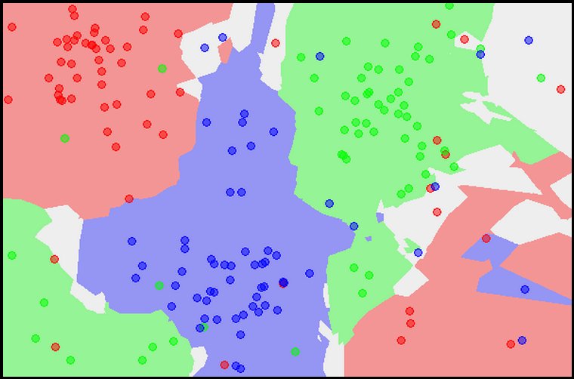
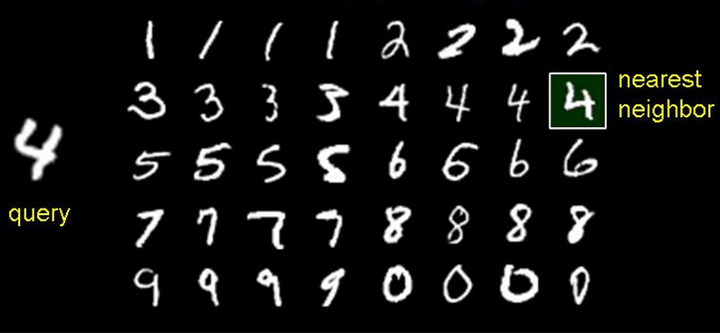
4.Case Study: K nearest neighbors (kNN)
- Common classify algorithm
Find K nearest neighbors from the training data by distance
O(MNP) time complexity for direct implementation
Benchmark: handwritten digits data of MNIST
Kaggle data size : test(~30k, ~2k), train(~40k, ~2k)
5-NN Classifier Map from Wikipedia
Image from ~athitsos
Notes:
Finally, we will use KNN algorithm with handwritten recognition dataset to show how to accelerate R in CUDA eco-system by different methods.
This algorithm finds K nearest neighbors from training set by specified distance function, such as in this picture, let’s assume, k=1, we query the label of this digit, and compare with all labeled data,
We find the nearest neighbor is 4, so we return 4 as result. Because each query needs to iterate all data set, so the time complexity is M*N*P for direct implementation.

Slide 26
Parallel Strategies
CRAN packages
directives
class:kNN
FNN :kNN
openACC
openMP
algorithm
represent by pattern
CUDA libraries
KNN
matrix solver
nvBLAS
R implementation
Custom Function
directives
isolate computationally
intensive task
openACC
openMP
rewrite by C/C++/Fortran
CUDA
Parallel
Algorithm
Notes:
In this page, I present the different parallel strategies in general. For a certain algorithm, you can consider to resolve by existing packages or write up by your self.
If you use existing packages, you can accelerate it by directives from openACC or openMP; otherwise, if you write you own R code and don’t satisfy with it’s performance;
You can represent it by pattern or vectorization, and then accelerate these patterns by CUDA libraries; alternatively, you can profile your code and then isolate computationally
Intensive task, and rewrite it by C/C++/Fortan. After rewriting by low level languages, you can speedup it either by directives or CUDA language.

Slide 27
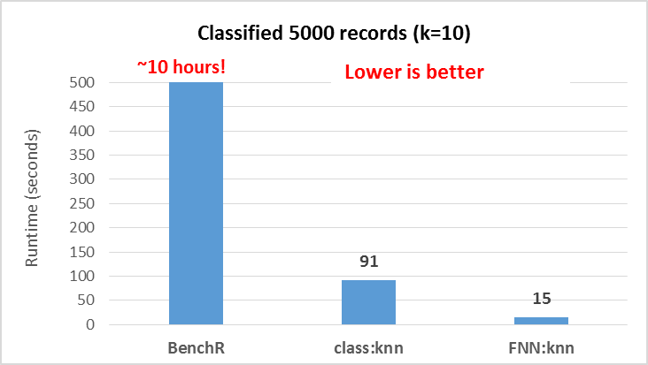

Basic Algorithm and Performance Baseline
Steps for kNN:
Query a record : compute distance, sort, return most frequent labels
$distance(j)=\sum_{k}^{P}{{({test}_{jk} −{train}_{jk})}_{}^{2}}$
Implementations:
Most common package
class:KNN ( C )
Fast package
FNN:KNN
(C++, fast algorithm kd-tree)
R implementation
BenchR (R with 1 loop )
CPU: Ivy Bridge E5-2690 v2 @ 3.00GHz, dual socket 10-core, 128G
GPU: Nvidia Kepler, K40, 6G
Notes:
Let’s go through the basic knn algorithm and setup performance baseline before we do optimization. As we talked previous, when we do a query, we need to compute distance with N*P complexity, and sort for first K neighbor with N*logN time complexity, and return the labels. So, the most time-consuming part is compute distance.
And then let’s the performance from three packages. …

Slide 28
Parallel Strategies
CRAN packages
directives
class:kNN
FNN :kNN
openACC
openMP
algorithm
represent by pattern
CUDA libraries
KNN
matrix solver
nvBLAS
R implementation
Custom Function
directives
isolate computationally
intensive task
openACC
openMP
rewrite by C/C++/Fortran
CUDA
Parallel
Algorithm
Notes:
First of all, let’s start from the slowest R implementation and see how GPU work with it.

Slide 29

Rewrite R implementation by pattern
distance = $\sum_{j}^{n}{\sum_{i}^{p}{{({test}_{i} −{train}_{i})}_{j}^{2}}}$
= $\sum_{j}^{n}{\sum_{i}^{p}{({test}_{i}^{2}}}$ - 2* ${test}_{i}$* ${train}_{i}$ + ${test}_{i}^{2})_{j}$
=$\sum_{j}^{n}{\sum_{i}^{p}{{test}_{ij}^{2}}}$ -2*$\sum_{j}^{n}{\sum_{i}^{p}{(}}{test}_{i}∗{train}_{i})_{j}+\sum_{j}^{n}{\sum_{i}^{p}{{train}_{ij}^{2}}}$
rowSums(test*test)
test %*% t(train)
rowSums(train*train)
Now, we have represented KNN algorithm by matrix operations, and we can easily accelerate it by CUDA libraries as we mentioned previously.
Notes:
Let’s review the distance computation, and we can rewrite it like this. And it’s obvious that these three parts can be presented by matrix of R commands.
Now, we have represented KNN algorithm by matrix operation, and we can easy to accelerate by CUDA libraries as we mentioned previously.

Slide 30
Rewrite KNN by matrix pattern and vectorization
#Rewrite BenchR kNN by matrix operations and vectorization
knn.customer.vectorization <- function(traindata, testdata, cl, k)
{
n <- nrow(testdata)
pred <- rep(NA_character_, n)
# (traindata[i,] - testdata[i, ])^2 --> (a^2 - 2ab + b^2)
traindata2 <- rowSums(traindata*traindata)
testdata2 <- rowSums(testdata*testdata)
# nvBLAS can speedup this step
testXtrain <- as.matrix(testdata) %*% t(traindata)
# compute distance
dist <- sweep(testdata2 - 2 * testXtrain, 2, traindata2, '+')
# get the k smallest neighbor
nn <- t(apply(dist, 1, order))[,1:k]
# get the most frequent labels in nearest K
class.frequency <- apply(nn, 1, FUN=function(i) table(factor(cl[i], levels=unique(cl))) )
# find the max label and break ties
pred <- apply(class.frequency, 2, FUN=function(i) sample(names(i)[i == max(i)],1))
unname(factor(pred, levels=unique(cl)))
}
Notes:
This is line to line translation for previous equations, and we replaced the loop structure in the original code of BenchR:knn by matrix and vectorization.

Slide 31
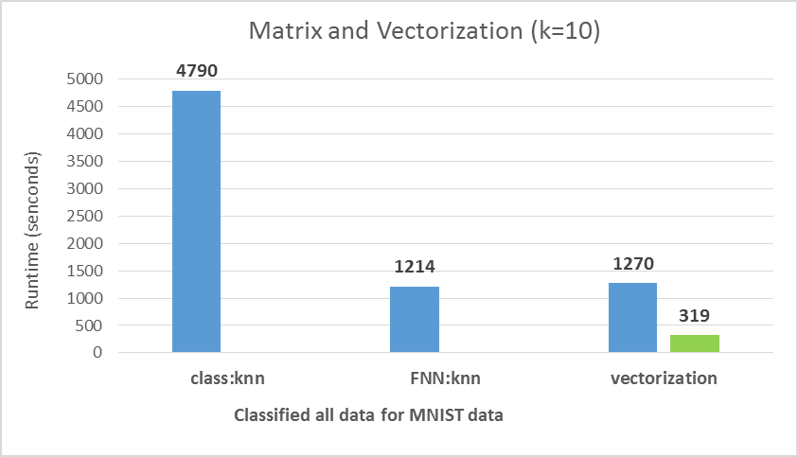
- Matrix version is as fast as FNN:knn
Run with nvBLAS we got:
15X faster than class:knn
3.8X faster than FNN:knn
Lower is better
Notes:
Now the matrix version’s code is as fast as FNN:knn, and when we use nvBLAS with it.
We get ….

Slide 32
Parallel Strategies
CRAN packages
directives
class:kNN
FNN :kNN
openACC
openMP
algorithm
represent by pattern
CUDA libraries
KNN
matrix solver
nvBLAS
R implementation
Custom Function
directives
isolate computationally
intensive task
openACC
openMP
rewrite by C/C++/Fortran
CUDA
Parallel
Algorithm
Notes:
Next step, let’s try isolate computationally intensive task and accelerate this part by directives.

Slide 33
Isolated computational task and rewrite by C
rewrite kNN by matrix operations and vectorization
knn.customer.vectorization <- function(traindata, testdata, cl, k)
{
n <- nrow(testdata)
pred <- rep(NA_character_, n)
# (traindata[i,] - testdata[i, ])^2 --> (a^2 - 2ab + b^2)
traindata2 <- rowSums(traindata*traindata)
testdata2 <- rowSums(testdata*testdata)
testXtrain <- as.matrix(testdata) %*% t(traindata)
# compute distance
dist <- sweep(testdata2 - 2 * testXtrain, 2, traindata2, '+')
# get the k smallest neighbor
nn <- t(apply(dist, 1, order))[,1:k]
# get the most frequent labels in nearest K
class.frequency <- apply(nn, 1, FUN=function(i) table(factor(cl[i], levels=unique(cl))) )
# find the max label and break ties
pred <- apply(class.frequency, 2, FUN=function(i) sample(names(i)[i == max(i)],1))
unname(factor(pred, levels=unique(cl)))
}
dist.C <- function(tndata, ttdata)
{
m <- nrow(ttdata)
n <- nrow(tndata)
p <- ncol(ttdata)
rst <- .C("compute_dist",
as.integer(n),
as.integer(m),
as.integer(p),
as.double(ttdata),
as.double(t(tndata)),
mm = double(length=m*n))
return(matrix(rst[["mm"]], nrow=m, ncol=n))
}
Notes:
We replace R code of all matrix computations by C function.

Slide 34


Write a C function
don’t need to transfer R to C line by line (use C accent!)
rethink KNN computations, which is really like GEMM
$$GEMM(i,j)=\sum_{k}^{P}{{(A_{ijk} ∗B_{ijk})}_{}^{}}$$
$$distance matrix(i, j)=\sum_{k}^{P}{{({test}_{ijk} −{train}_{ijk})}_{}^{2}}$$
Notes:
In C level, …

Slide 35
So, we write C code by GEMM style for KNN
void compute_dist(int *m, int *n, int *p, double *traindata, double *testdata, double *result);
void compute_dist(int *m, int *n, int *p, double *traindata, double *testdata, double *result)
{
int i = 0, j = 0, k = 0 ;
// Compute Distance Matrix
for(i = 0; i < (*m); i++)
for(k = 0; k < (*p); k++)
for(j = 0; j < (*n); j++)
{
// GEMM
// result[i* (*n) +j] += testdata[i* (*p) +k] * traindata[k * (*n) +j];
// KNN
double dist = testdata[i* (*p) +k] - traindata[k * (*n) +j];
result[i* (*n) +j] += dist * dist ;
}
}

Slide 36
And then, accelerate by openACC
void compute_dist(int* m, int* n, int* p, double* restrict traindata, double* restrict testdata, double* restrict result);
void compute_dist(int* m, int* n, int* p, double* restrict traindata, double* restrict testdata, double* restrict result)
{
int i = 0, j = 0, k = 0 ;
int mm = *m, nn = *n, pp = *p;
// Compute Distance Matrix
#pragma acc data copyout(result[0 : (mm * nn) -1]), copyin(testdata[0 : (mm * pp) -1], traindata[0 : (pp * nn) -1])
{
#pragma acc region for parallel, private(i), vector(8)
for(i = 0; i < mm; i++) {
#pragma acc for parallel,private(j,k), vector(8)
for(j = 0; j < nn; j++) {
#pragma acc for seq
for(k = 0; k < pp; k++) {
double tmp = testdata[i* pp +k] - traindata[k * nn +j];
result[i* nn +j] += tmp * tmp ;
}}}
} // end openACC data region
}

Slide 37
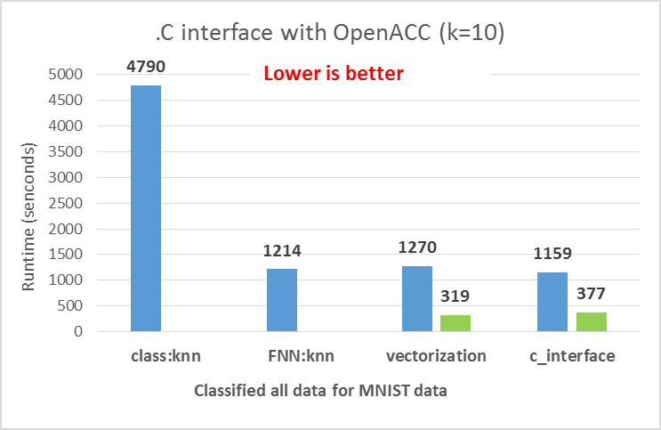
- C version is as fast as FNN:knn
Compile with PGI (-Mlarge_arrays), we got:
13X faster than class:knn
3.2X faster than FNN:knn

Slide 38
Parallel Strategies
CRAN packages
directives
class:kNN
FNN :kNN
openACC
openMP
algorithm
represent by pattern
CUDA libraries
KNN
matrix solver
nvBLAS
R implementation
Custom Function
directives
isolate computationally
intensive task
openACC
openMP
rewrite by C/C++/Fortran
CUDA
Parallel
Algorithm
Notes:
Finally, let’s see how to accelerate CRAN packages by directives.

Slide 39
Accelerate CRAN packages by directive
May be not easy since the package structure will be complex
Need to fully understand algorithms and their implementations
Select proper data decomposition method
coarse granularity – openMP
finer granularity - openACC
Class:KNN : source code is under:
<R source code path>/src/library/Recommended/class/src/class.c
knn function: VR_knn(…)

Slide 40
Coarse Granularity Decomposition
void
VR_knn(Sint *kin, Sint *lin, Sint *pntr, Sint *pnte, Sint *p,
double *train, Sint *class, double *test, Sint *res, double *pr,
Sint *votes, Sint *nc, Sint *cv, Sint *use_all)
{
……
// Patric: Coarse Granularity Parallel by openMP
#pragma omp parallel for \
private(npat, i, index, j, k, k1, kn, mm, ntie, extras, pos, nclass, j1, j2, needed, t, dist, tmp, nndist) \
shared(pr, res, test, train, class, nte, ntr, nc)
for (npat = 0; npat < nte; npat++) {
…..
// Patric : each thread malloc new buffer to resolve memory conflict of votes
// change all votes to __votes in below source code.
// Calloc is thread-safe function located in memory.c.
Sint *__votes = Calloc(nc+1, Sint);
…..
Free(__votes);
} // Patric: Top iteration and end of openMP
RANDOUT;
}
Notes:
Here ,we also add several pragma omp statement in the out of loop as normally. But very trick thing is in here, which also is the difficult part when we change legacy code.
You should be careful about data conflict. Running valgrind is a good option.

Slide 41
Finer Granularity Decomposition
void
VR_knn(Sint *kin, Sint *lin, Sint *pntr, Sint *pnte, Sint *p,
double *train, Sint *class, double *test, Sint *res, double *pr,
Sint *votes, Sint *nc, Sint *cv, Sint *use_all)
{
……
// Patric: Finer Granularity Parallel by openACC
#pragma acc data copyin(test[0:nn*nte], train[0: nn*ntr])
for (npat = 0; npat < nte; npat++) {
…..
// Only parallelize this loop for Least Squares Model
#pragma acc parallel loop private(k), reduction(+:dist)
for (k = 0; k < *p; k++) {
tmp = test[npat + k * nte] - train[j + k * ntr];
dist += tmp * tmp;
}
……
}
RANDOUT;
}

Slide 42
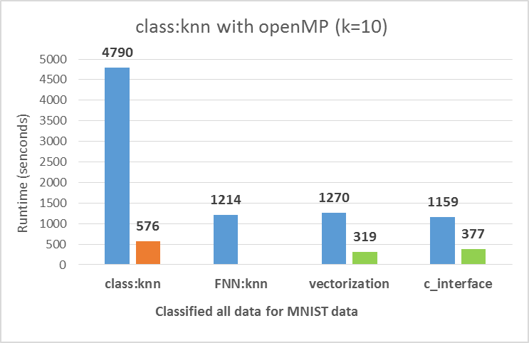

- OpenACC version is not fast than original (only 2k features)
OpenMP (1 CPU, 10 threads) is faster , we got:
8.3X faster than class:knn
2.3X faster than FNN:knn
Notes:
In this case, each digit is represented by about 2000 features so it’s related a small workload for GPU and we don’t get performance improvement in this case.
But for openMP ….

Slide 43
Further :
Our post includes more details:
http://devblogs.nvidia.com/parallelforall/author/patricz/
Learn more on GTC 2015
CUDA General (tools, libraries)
S5820 - CUDA 7 and Beyond
S5832 - Hangout: Tools & Libraries
CUDA Programming
S5651 - Hands-on Lab: Getting Started with CUDA C/C++
S5661 - Session 1 of 4: An Introduction to CUDA Programming
S5662 - Session 2 of 4: An Introduction to the GPU Memory Model
S5663 - Session 3 of 4: Asynchronous Operations & Dynamic Parallelism in CUDA
S5664 - Session 4 of 4: Essential CUDA Optimization Techniques
Directives
S5652 - Hands-on Lab: Accelerating Code on GPUs with Compiler Directives
S5830 - Hangout: OpenACC and Other Directives
S5192 - Introduction to Compiler Directives with OpenACC
Handwritten Digit Recogination
S5674 - Hands-on Lab: Introduction to Machine Learning with GPUs: Handwritten Digit Classification

Slide 44
Appendix: Build R with CUDA by Visual Studio 2013 on Windows
1. Download and install Visual Studio 2013
http://www.visualstudio.com/downloads/download-visual-studio-vs
2. Download and install CUDA toolkit
https://developer.nvidia.com/cuda-toolkit

Slide 45
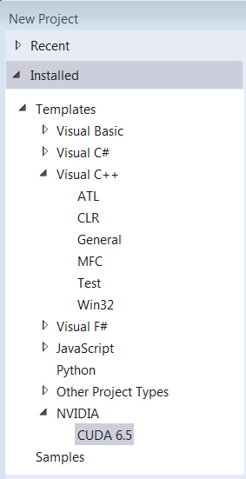
3. Open VS2013, and create ‘New Project’ then you will see NVIDIA/CUDA item.

Slide 46
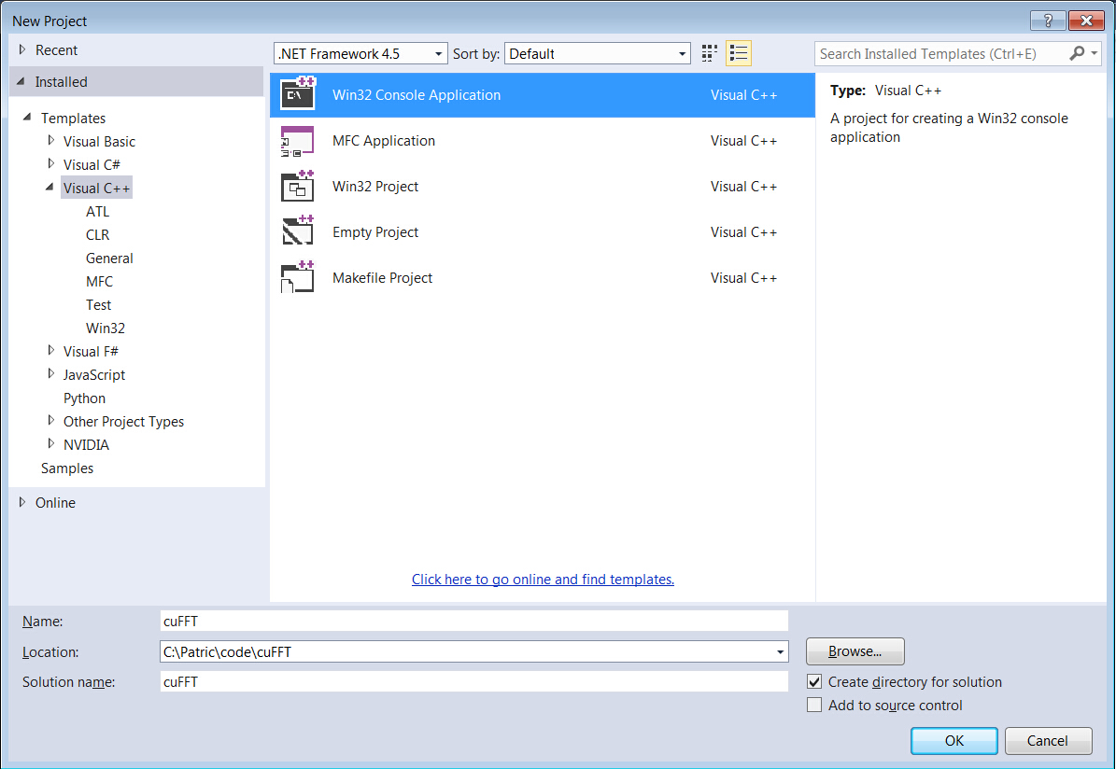
4. Select ‘Visual C++’ → ‘Win32 Console Application’

Slide 47
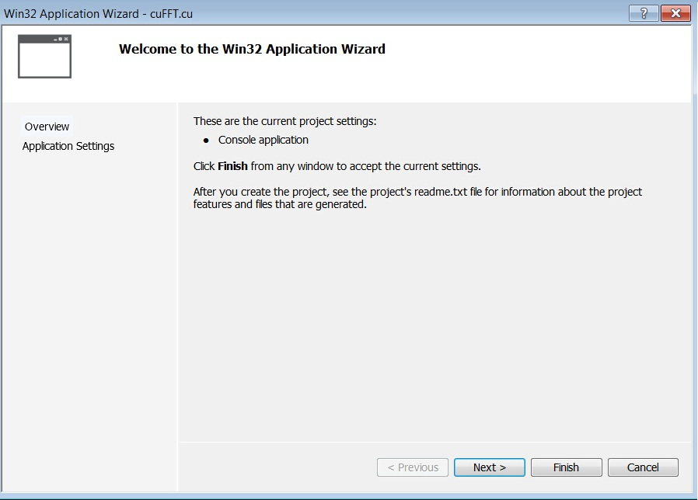
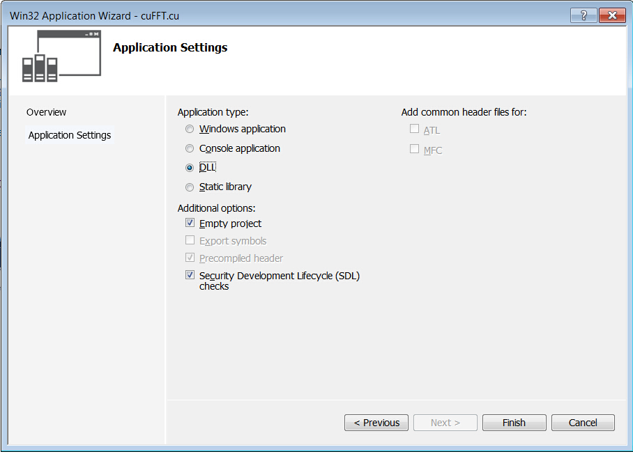
5. Select ‘DLL’ for Application type to create a ‘Empty project’ in Wizard platform

Slide 48
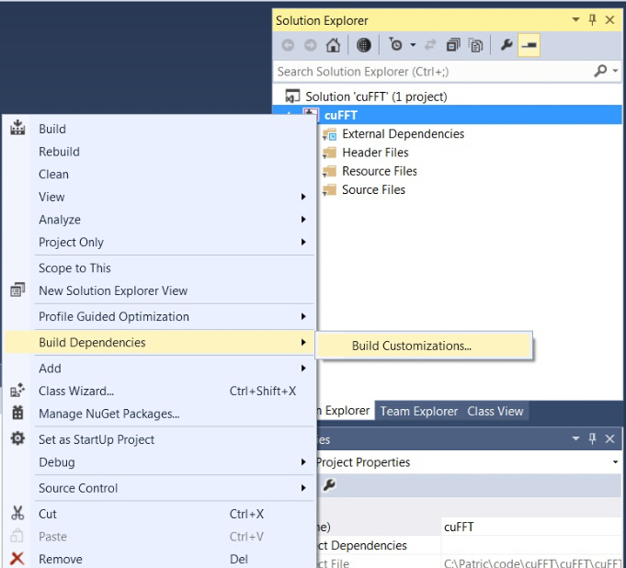
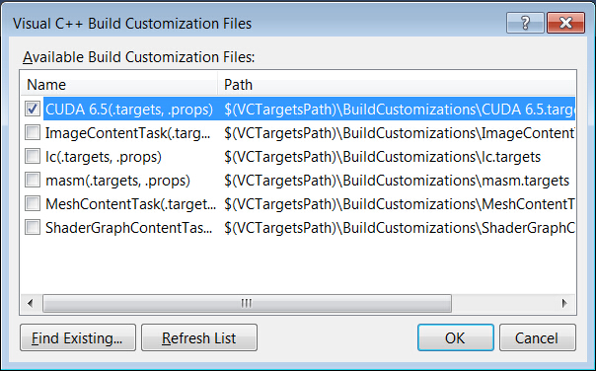
6. Changes Project type to CUDA
‘Solution Explorer’ →
right click project name →
‘Build Dependencies’ →
‘Build Customizations…’ →
‘CUDA 6.5’

Slide 49
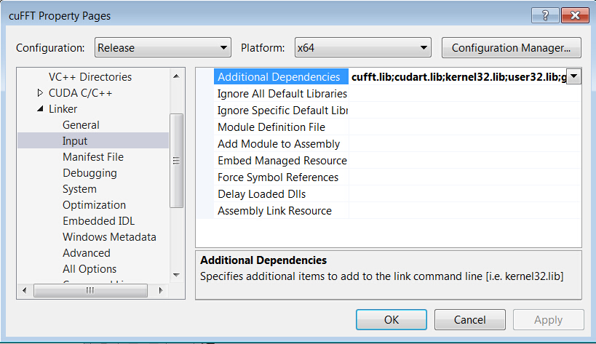
7. Add cuda and cuda accelerated libraries into Visual Studio
Right project name in ‘Solution Explorer’ →
‘Properties’ → ‘Linker’ → ‘Input’ → ’Additional Dependencies’
Add “cufft.lib” and “cudart.lib”

Slide 50
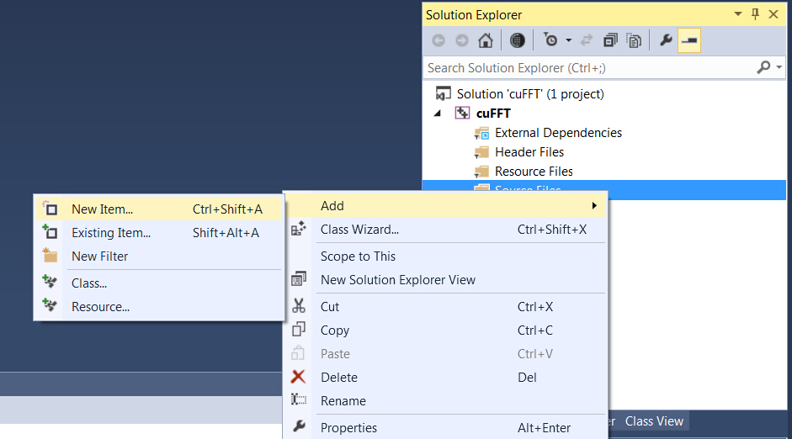
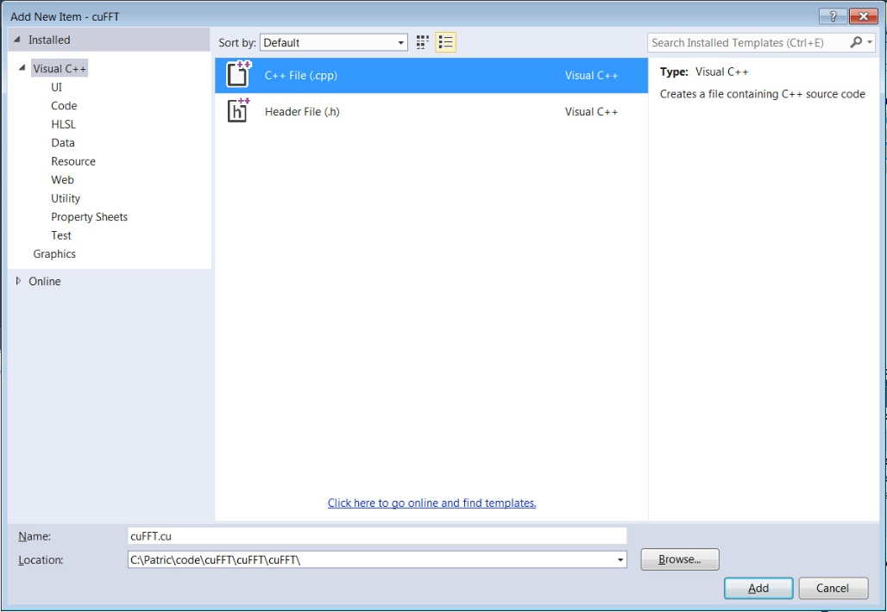
8. Add CUDA source code file with .cu suffix
Right click “Source Files” in “Solution Explorer”
‘Add’
‘New Item’
‘C++ File(.cpp)’
type cuFFt.cu

Slide 51
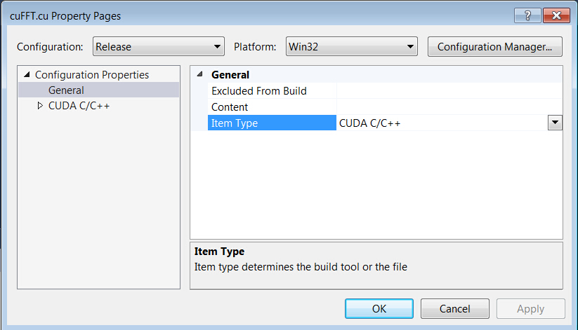
- Check the ‘Item type’ of cuFFT.cu by right clicking filename (cuFFT.cu) and selecting ‘Properties’.
- The type should be ‘CUDA C/C++’; otherwise, change to CUDA type.

Slide 52
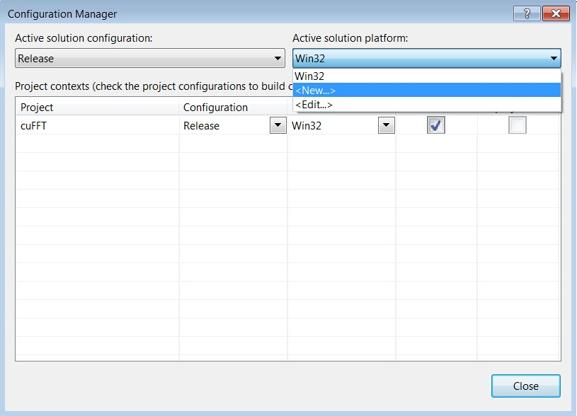
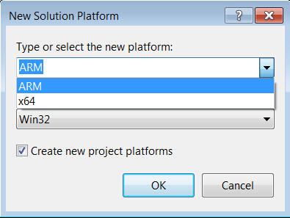
9. Change to 64bit in case you are using 64bit R and CUDA
‘Build’
‘Configuration Manager’
‘Active solution platform:’
‘New’
select ‘x64’

Slide 53
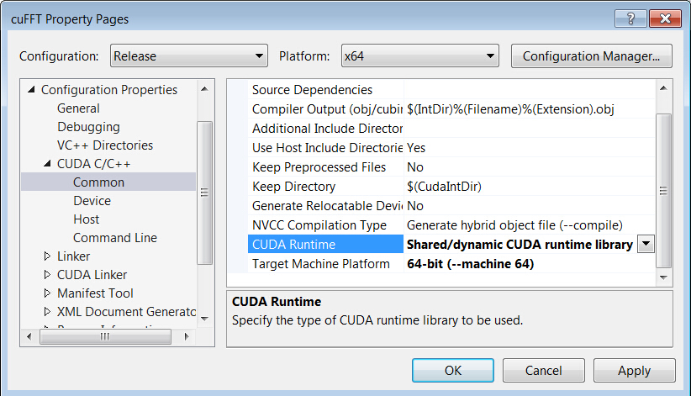
10. Select 64bit CUDA and shared runtime
Right project name in ‘Solution Explorer’
‘Properties’ → ‘CUDA C/C++’ → ‘Common’
Select :
‘Shared/dynamic CDUA runtime library’ in CUDA Runtime
’64-bit (--machine 64)’ in Target Machine Platform

Slide 54
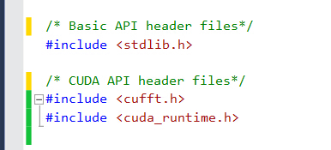
11. Copy your CUDA code into this file
Add necessary header files for CUDA
Declare routines which need to call from R with
extern “c” __declspec(dllexport)

Slide 55
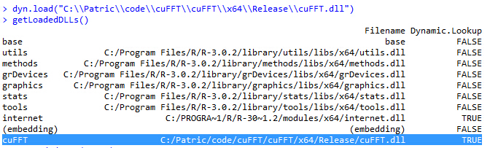
12. Build Project and get cuFFT.dll
13. Load cuFFT.dll in R and check the dll path

Slide 56
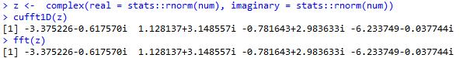
14. Run cuFFT in R on Windows

Slide 57
Common Errors
solution: add cudart.lib as in 7) in our Appendix
2. DYN load Error
solution:
- check if you build the same bit version of R and dll
- change dll type as 9) and 10)
1. LNK unresolved external symbol
Error 72 error LNK2001: unresolved external symbol cudaFree
“Error in inDL(x, as.logical(local), as.logical(now), ...) :
unable to load shared object ‘../cuFFT.dll':
LoadLibrary failure: %1 is not a valid Win32 application.”

